Slide 1


Algorithms
Notes:
1

Slide 2

Group Member
Notes:
7

Slide 3

What is an Algorithm?
An algorithm is a finite, step-by-step sequence of well-defined instructions used to solve a specific problem or perform a computation.
In simple terms, it is a logical "map." You provide an input (data), the algorithm follows a set of rules, and it produces an output (the result).
Key properties
Analogy
Why it matters
Deterministic steps, termination, and measurable resources.
Recipe → precise order; wrong order = failed dish (bug).
Algorithms power everything from search to real‑time systems.
Notes:
2

Slide 4



The Power of Visualisation: Bringing Algorithms to Life
Visualisations convert abstract steps into motion: pointers, swaps, node expansions and colour changes reveal behaviour over time. They reduce cognitive load and expose performance patterns (best/worst/average cases). Use interactive tools during the talk to demonstrate the dynamics live.
Sorting animators
Pathfinding demos
Structure traversal
Step through comparisons and swaps to see where time is spent.
Watch BFS/DFS expansion patterns and Dijkstra's distance updates.
Visual step order clarifies recursion and stack behaviour.
Notes:
3

Slide 5

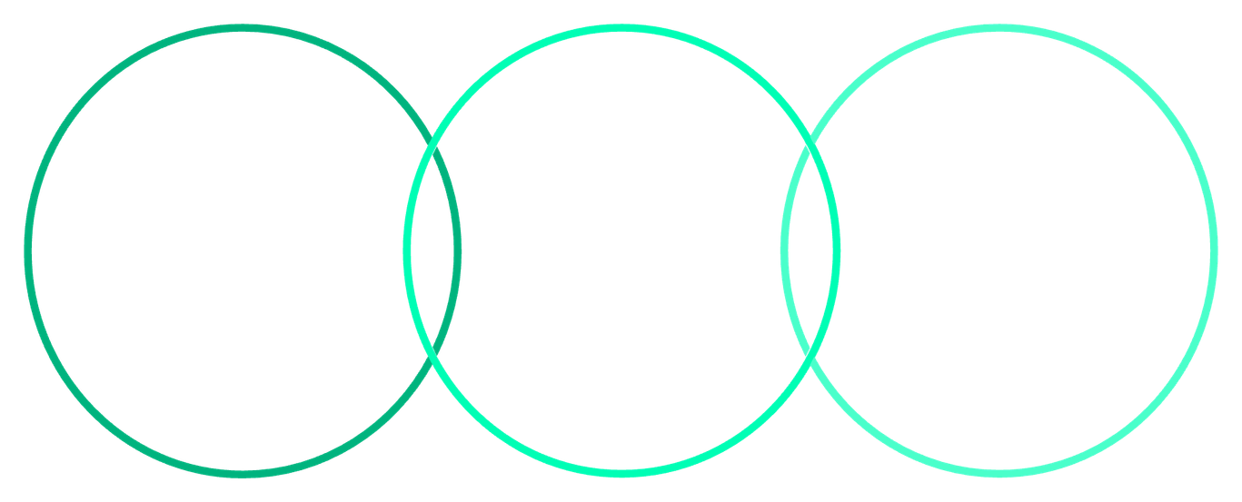

Graph Algorithms: Navigating the Connected World
Graphs model relationships: road networks, social graphs, dependency trees. Understanding traversal and pathfinding is critical for routing, recommendations, and network analysis.
BFS
Dijkstra
A*
Layered exploration, unweighted
Weighted shortest path, priority queue
Heuristic-guided shortest path
Use the diagram to explain: BFS explores uniformly (unweighted), Dijkstra handles weights with a priority queue, and A* adds heuristics for efficient search when good estimates exist.
Notes:
5

Slide 6

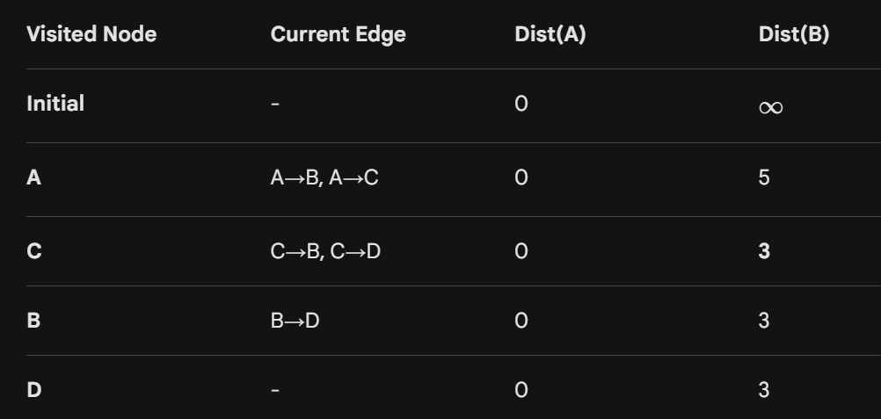
Dijkstra’s Algorithm
Imagine a small network of four cities (Nodes A, B, C, D).
A → B (weight 5)
A → C (weight 2)
C → B (weight 1)
C → D (weight 9)
B → D (weight 3)
Notes:
6

Slide 7

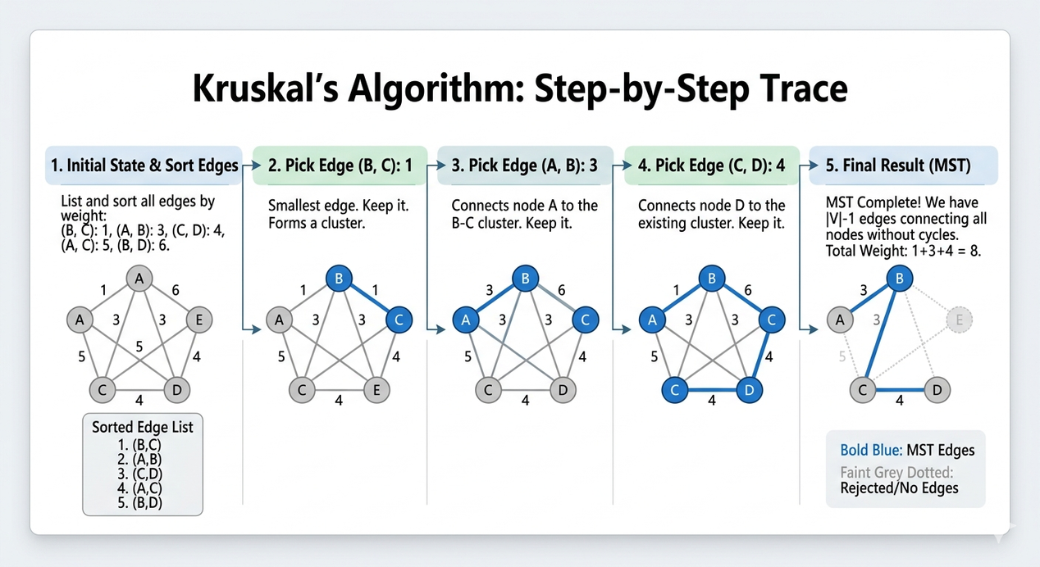
Kruskal’s Algorithm
Kruskal’s Algorithm is a great move because it highlights a different goal: instead of finding the shortest path between two points, Kruskal’s finds the Minimum Spanning Tree (MST)—the cheapest way to connect all points in a network without any loops.
Notes:
7

Slide 8

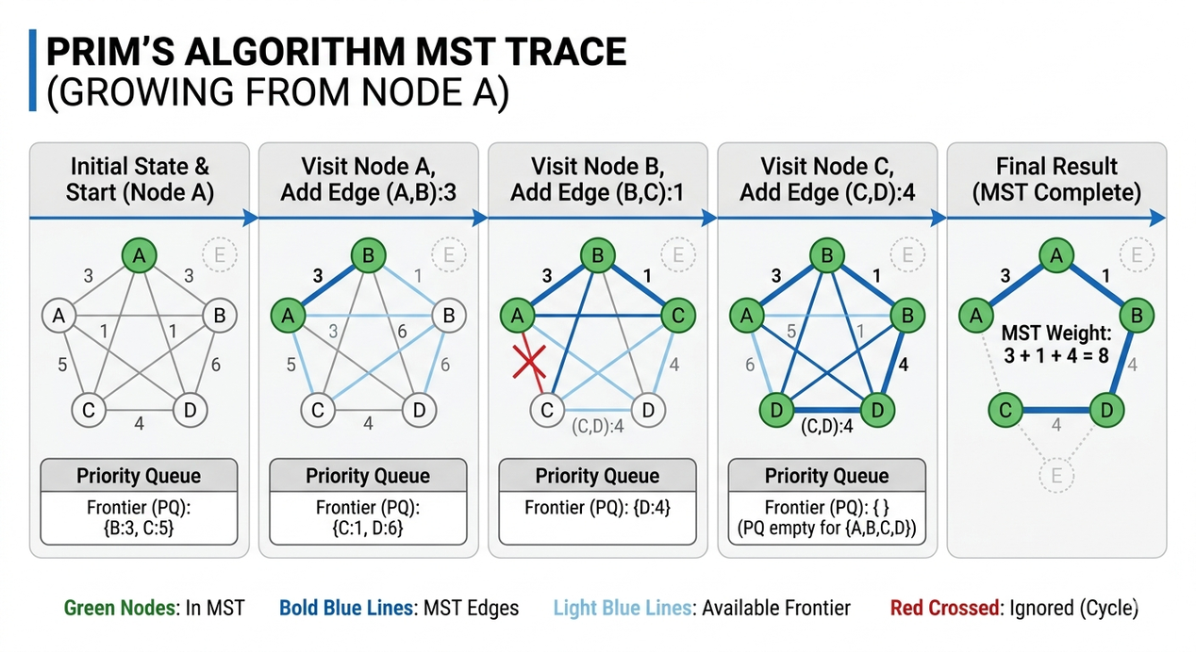
Prim’s Algorithm
Prim’s Algorithm is the perfect final piece for your presentation. While Kruskal’s focuses on the shortest edges anywhere in the graph, Prim’s focuses on the nodes, growing the tree like a spreading vine from a single starting point.
Notes:
8

Slide 9

Thank You
Notes:
1

